Slide 1
My olivernet CNN
GSERM - Deep Learning: Fundamentals and Applications (2024)
Joachim Oliver Mampouya

Slide 2
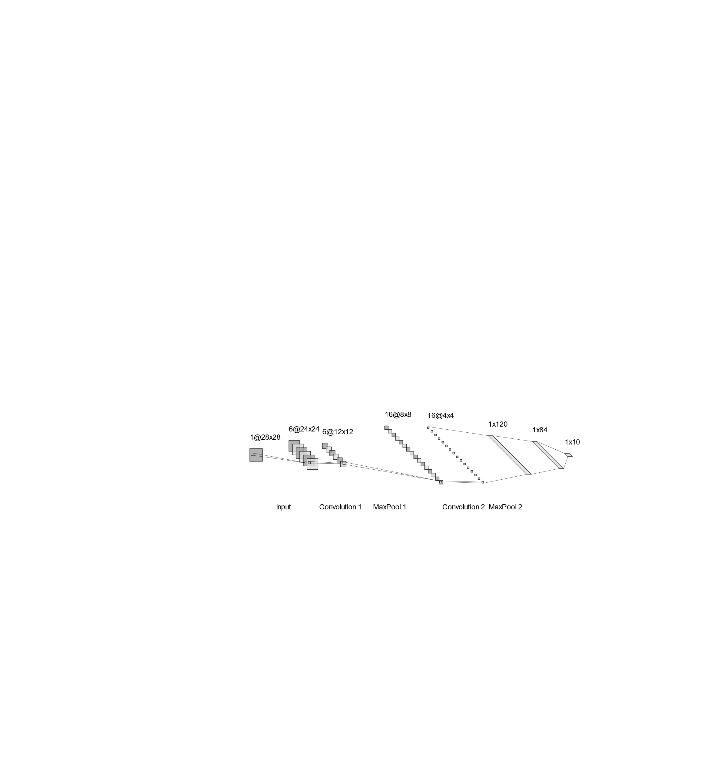
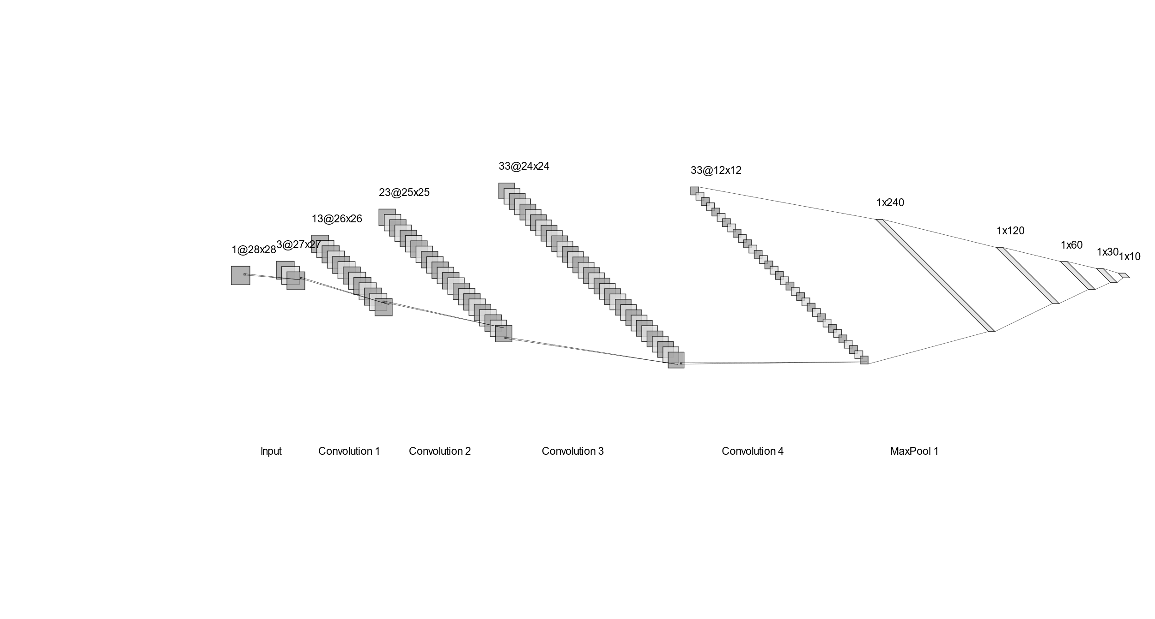
Architecture - Baseline (top) vs Improved (bottom)

Slide 3
Process of network building
As a baseline CNN, I have copied the structure of LeNet, it seemed to be a good benchmark. I tried some quick training and arrived at an accuracy of 0.3697, however, then I decided to train it for more epochs and with a higher learning rate. I have reached the accuracy of 0.8989 that I tried to beat. The following slides show a comparison of the accuracy and confusion matrix.

Slide 4
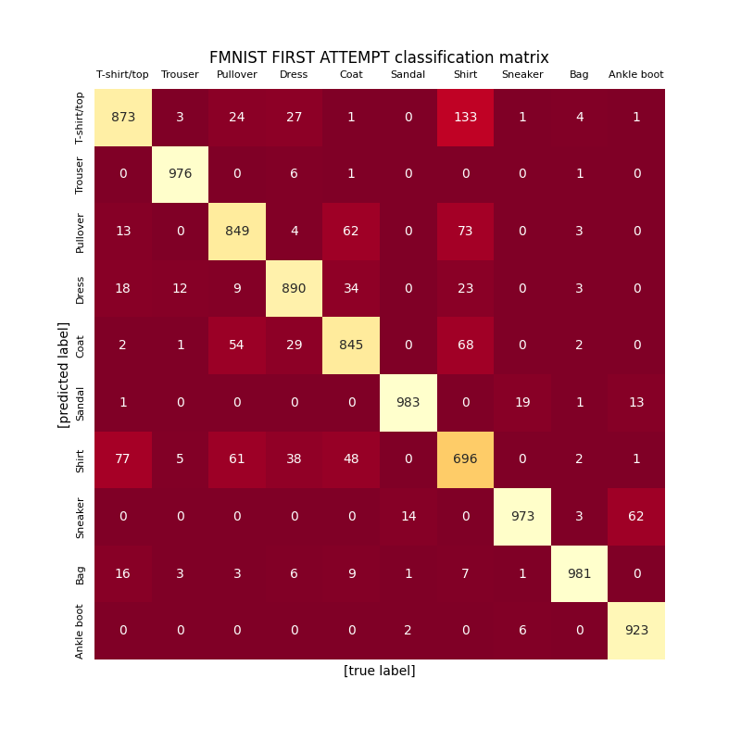
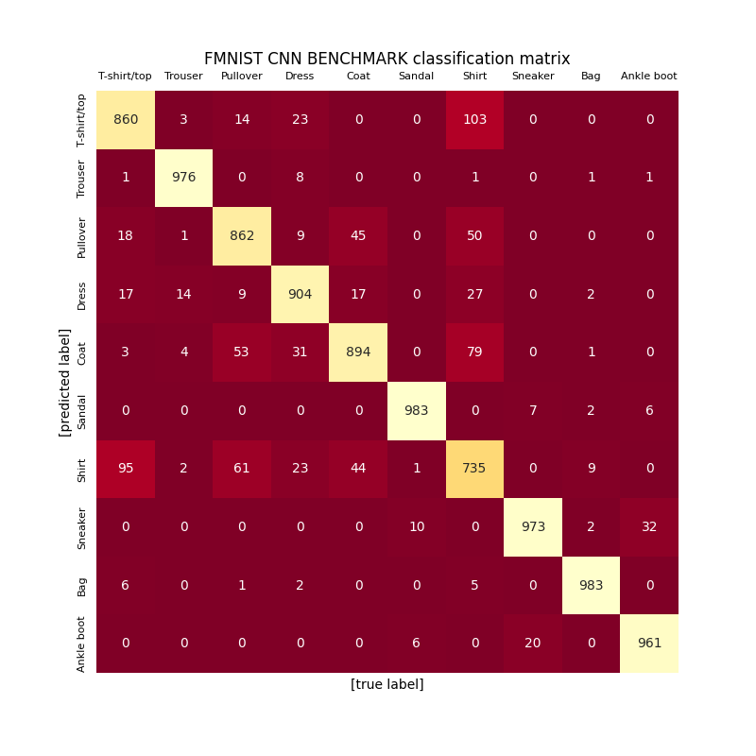
Accuracy and confusion matrices
Baseline model: Accuracy: 0.8989
Improved model:
Accuracy: 0.9131

Slide 5
Both CNNs performed relatively similarly, the only category the CNNs were having problems with was the Shirt category. T-shirts, Pullovers, and Shirts these are similar. Improved CNN could distinguish correctly in more cases than the baseline CNN. The only category, where the baseline CNN is performing better is the T-shirt one. Other than that, the new CNN outperforms in all regards.

Slide 6
There may be various reasons why my improved CNN was able to outperform baseline CNN. Of course, the depth could be helpful as I used two more convolution layers, allowing me to potentially capture other features, where only 2 layers may not be enough. I also added normalization layers, which may be useful for handling the training part better. There are more fully connected layers, that also add the learning capacity of the network and the ability to capture more non-linear relationships using the ReLU activation function. There is also only 1 pooling after all convolutional layers, instead of pooling after each one. This may lead to a lesser loss of information in the process.

Slide 7
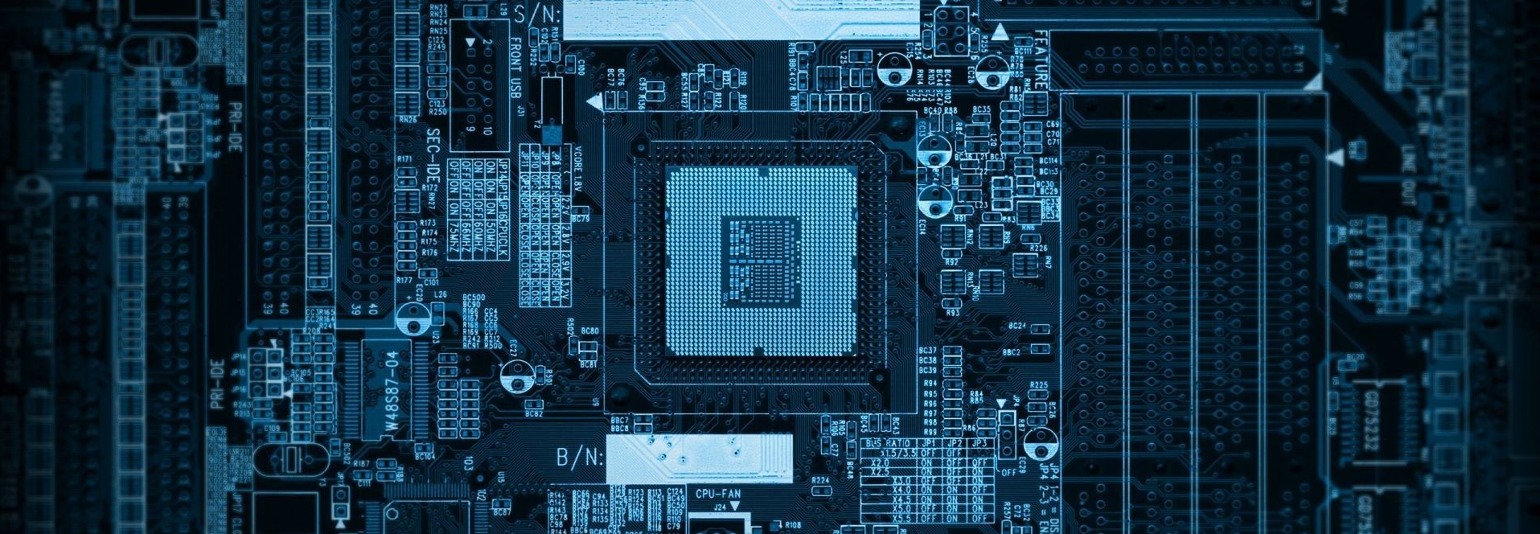
Thank you for reading this presentation!

